Slide 1
Graphs
CSE225: Data Structures and Algorithms

Slide 2
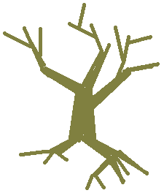
Graphs
Recap: The tree data structure
Nodes
Parent-child relation between two nodes

Slide 3
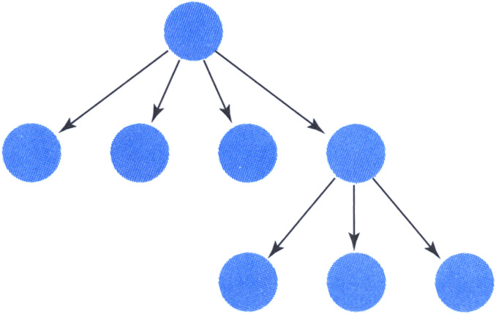
Graphs
Recap: The tree data structure
Nodes
Parent-child relation between two nodes
Remove the restriction that each node may have only one parent node
We have a graph
a
b
c
d
e

Slide 4
Graphs
Graph: A data structure that consists of a set of nodes and a set of connections that relate the nodes to one another
Vertex: A node in a graph
Edge (arc): A pair of vertices representing a connection between two nodes in a graph
Undirected graph: A graph in which the edges have no direction
Directed graph (digraph): A graph in which each edge is directed from one vertex to another (or the same) vertex
a
b
a
b
vertex
c
edge
c
d
e
d
e
Undirected graph
Directed graph

Slide 5
Graphs
A graph G is represented as G = (V,E), where
V: set of vertices
E: set of edges connecting the vertices in V
An edge e = (u,v) is a pair of vertices
Example:
a
b
V= {a,b,c,d,e}
E= {(a,b),(a,c),(a,d),
(b,e),(c,d),(c,e), (d,e)}
c
d
e

Slide 6
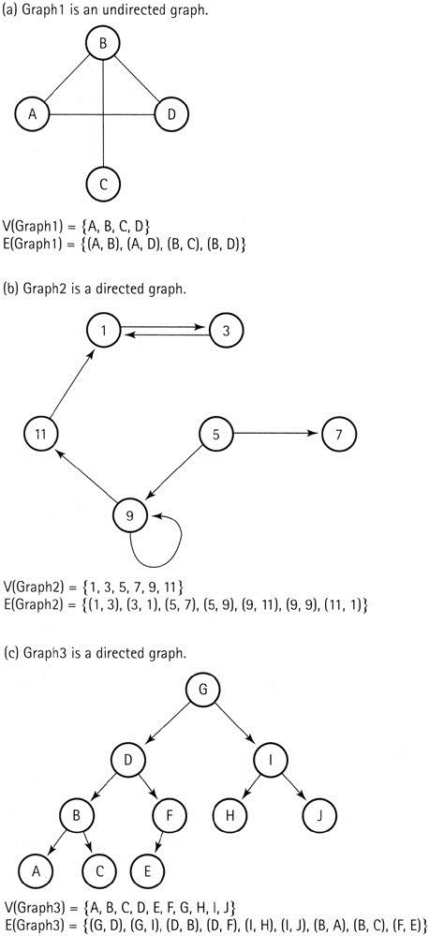
Graphs
Example: Graph1

Slide 7
Graphs
Example: Graph2

Slide 8
Graphs
Example: Graph3

Slide 9
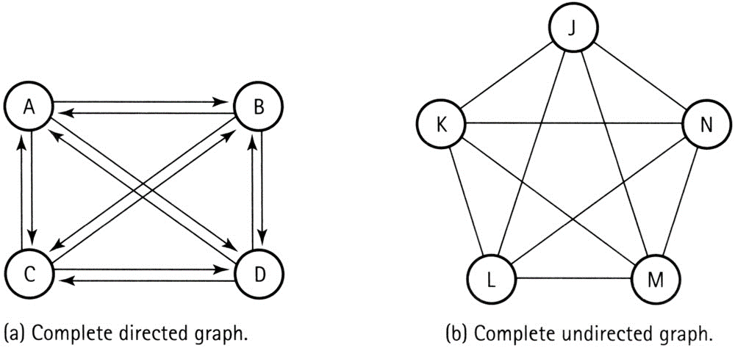
Graphs
Complete graph: A graph in which every vertex is directly connected to every other vertex

Slide 10
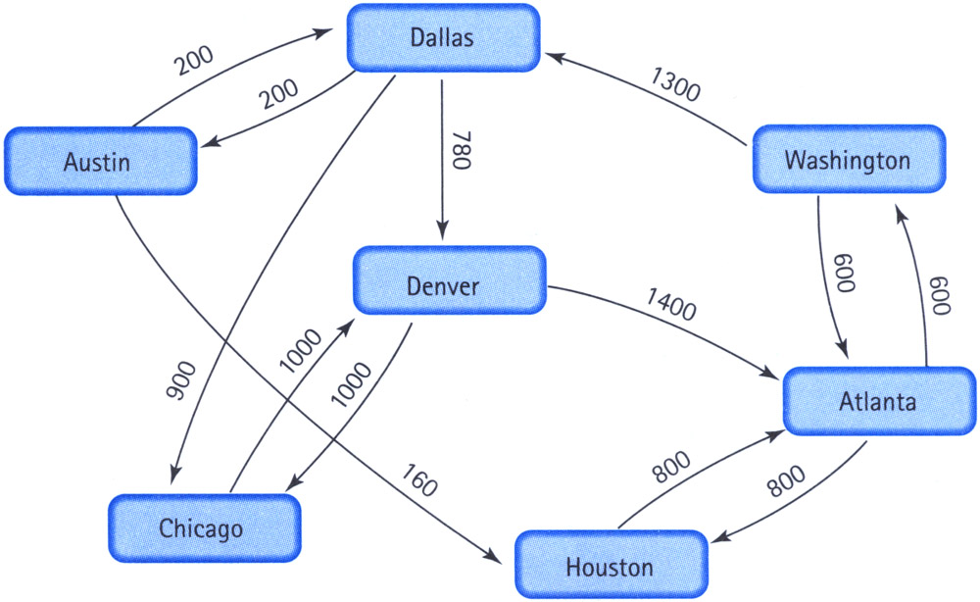
Graphs
Weighted graph: A graph in which each edge carries a value (cost)

Slide 11
Graphs
Adjacent vertices: Two vertices in a graph that are connected by an edge
Path: A sequence of vertices that connects two nodes in a graph

Slide 12
Implementation Issues
How can we store a graph in memory?
 | [0] | [1] | [2] | [3] | [4] | [5] | [6] | [7] | [8] | [9]
[0] | 0 | 0 | 0 | 0 | 0 | 800 | 600
[1] | 0 | 0 | 0 | 200 | 0 | 160 | 0
[2] | 0 | 0 | 0 | 0 | 1000 | 0 | 0
[3] | 0 | 200 | 900 | 0 | 780 | 0 | 0
[4] | 1400 | 0 | 1000 | 0 | 0 | 0 | 0
[5] | 800 | 0 | 0 | 0 | 0 | 0 | 0
[6] | 600 | 0 | 0 | 1300 | 0 | 0 | 0
[7]
[8]
[9]
0 | Atlanta
1 | Austin
2 | Chicago
3 | Dallas
4 | Denver
5 | Houston
6 | Washington
7
8
9
Vertices
Edges

Slide 13
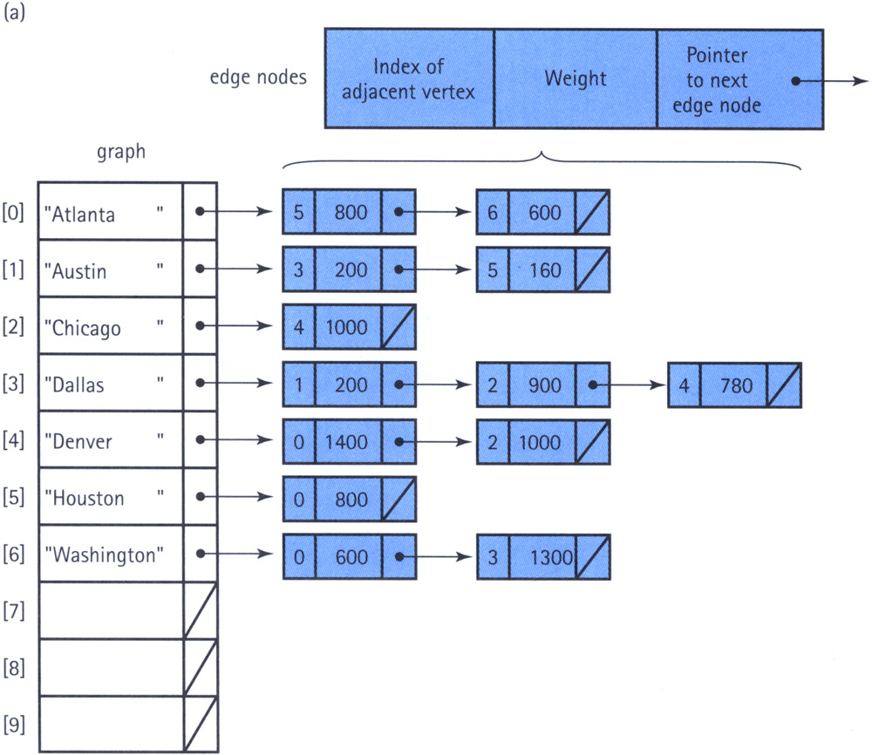
Implementation Issues
How can we store a graph in memory using (adjacent vertices)?
Vertices
Edges

Slide 14
Graph Specification
Structure: | The graph consists of a set of vertices and a set of weighted edges that connect some or all of the vertices to one another.
Operations:
MakeEmpty
Function | Initializes the graph to an empty state.
Postcondition | Graph is empty.
Boolean IsEmpty
Function | Tests whether the graph is empty.
Postcondition | Returns true if graph is empty and false otherwise.
Boolean IsFull
Function | Tests whether the graph is full.
Postcondition | Returns true if graph is full and false otherwise.

Slide 15
Graph Specification
AddVertex(VertexType vertex)
Function | Adds vertex to the graph.
Precondition | Graph is not full.
Postcondition | vertex is in V(graph).
AddEdge(VertexType fromVertex, VertexType toVertex, EdgeValueType weight)
Function | Adds an edge with the specified weight from fromVertex to toVertex.
Precondition | fromVertex and toVertex are in V(graph).
Postcondition | (fromVertex, toVertex) is in E(graph) with the specified weight.

Slide 16
Graph Specification
EdgeValueType WeightIs(VertexType fromVertex, VertexType toVertex)
Function | Determines the weight of the edge from fromVertex to toVertex.
Precondition | fromVertex and toVertex are in V(graph).
Postcondition | Function value = weight of edge from fromVertex to toVertex, if edge exists. If edge does not exist, function value = special "null-edge" value.
GetToVertices(VertexType vertex, QueType& vertexQ)
Function | Returns a queue of the vertices that are adjacent from vertex.
Precondition | vertex is in V(graph).
Postcondition | vertexQ contains the names of all vertices that are adjacent from vertex.

Slide 17
graphtype.h
#include "QueType.h"
template<class VertexType>
class GraphType
{
public:
GraphType();
GraphType(int maxV);
~GraphType();
void MakeEmpty();
bool IsEmpty() const;
bool IsFull() const;
void AddVertex(VertexType);
void AddEdge(VertexType, VertexType, int);
int WeightIs(VertexType, VertexType);
void GetToVertices(VertexType, QueType<VertexType>&);
void ClearMarks();
void MarkVertex(VertexType);
bool IsMarked(VertexType);
private:
int numVertices;
int maxVertices;
VertexType* vertices;
int **edges;
bool* marks;
};

Slide 18
graphtype.cpp
#include "GraphType.h"
template<class VertexType>
GraphType<VertexType>::GraphType()
{
numVertices = 0;
maxVertices = 50;
vertices = new VertexType[50];
edges = new int*[50];
for(int i=0;i<50;i++)
edges[i] = new int [50];
marks = new bool[50];
}
template<class VertexType>
GraphType<VertexType>::GraphType(int maxV)
{
numVertices = 0;
maxVertices = maxV;
vertices = new VertexType[maxV];
edges = new int*[maxV];
for(int i=0;i<maxV;i++)
edges[i] = new int [maxV];
marks = new bool[maxV];
}

Slide 19
graphtype.cpp
template<class VertexType>
GraphType<VertexType>::~GraphType()
{
delete [] vertices;
delete [] marks;
for(int i=0;i<maxV;i++)
delete [] edges[i];
delete [] edges;
}
const int NULL_EDGE = 0;
template<class VertexType>
void GraphType<VertexType>::AddVertex(VertexType vertex)
{
vertices[numVertices] = vertex;
for (int index = 0; index < numVertices; index++)
{
edges[numVertices][index] = NULL_EDGE;
edges[index][numVertices] = NULL_EDGE;
}
numVertices++;
}

Slide 20
graphtype.cpp
template<class VertexType>
int IndexIs(VertexType* vertices, VertexType vertex)
{
int index = 0;
while (!(vertex == vertices[index]))
index++;
return index;
}
template<class VertexType>
void GraphType<VertexType>::AddEdge(VertexType fromVertex,
VertexType toVertex, int weight)
{
int row = IndexIs(vertices, fromVertex);
int col= IndexIs(vertices, toVertex);
edges[row][col] = weight;
}

Slide 21
graphtype.cpp
template<class VertexType>
int GraphType<VertexType>::WeightIs(VertexType fromVertex, VertexType toVertex)
{
int row = IndexIs(vertices, fromVertex);
int col= IndexIs(vertices, toVertex);
return edges[row][col];
}
template<class VertexType>
void GraphType<VertexType>::GetToVertices(VertexType vertex, QueType<VertexType>& adjVertices)
{
int fromIndex;
int toIndex;
fromIndex = IndexIs(vertices, vertex);
for (toIndex = 0; toIndex < numVertices; toIndex++)
if (edges[fromIndex][toIndex] != NULL_EDGE)
adjVertices.Enqueue(vertices[toIndex]);
}

